Slide 1


AI Cognitive Services
Custom Vision
Notes:
Welcome to GABC 2019 - Thank you for attending!
Thank you Microsoft for providing this venue!

Slide 2



I am
Peter Piper
LinkedIn: https://www.linkedin.com/in/peterpiper
Twitter: @petpipe
Co-host and Co-organizer of the Mile High Azure meetup group

Slide 3
Intro
AI Consumption
Custom Vision
Demo
Summary

Slide 4
AI - Consumption
Responsible Citizen
Strategy
Ethics and Culture
Governance and Policies
Technology
Notes:
Before I jump in…
We need to talk briefly on consumption of AI technologies
In essence - How to become a Responsible Citizen?
Strategy
Ethics and Culture
Governance and Policies
Technology
Where can you get guidance on these topics?

Slide 5
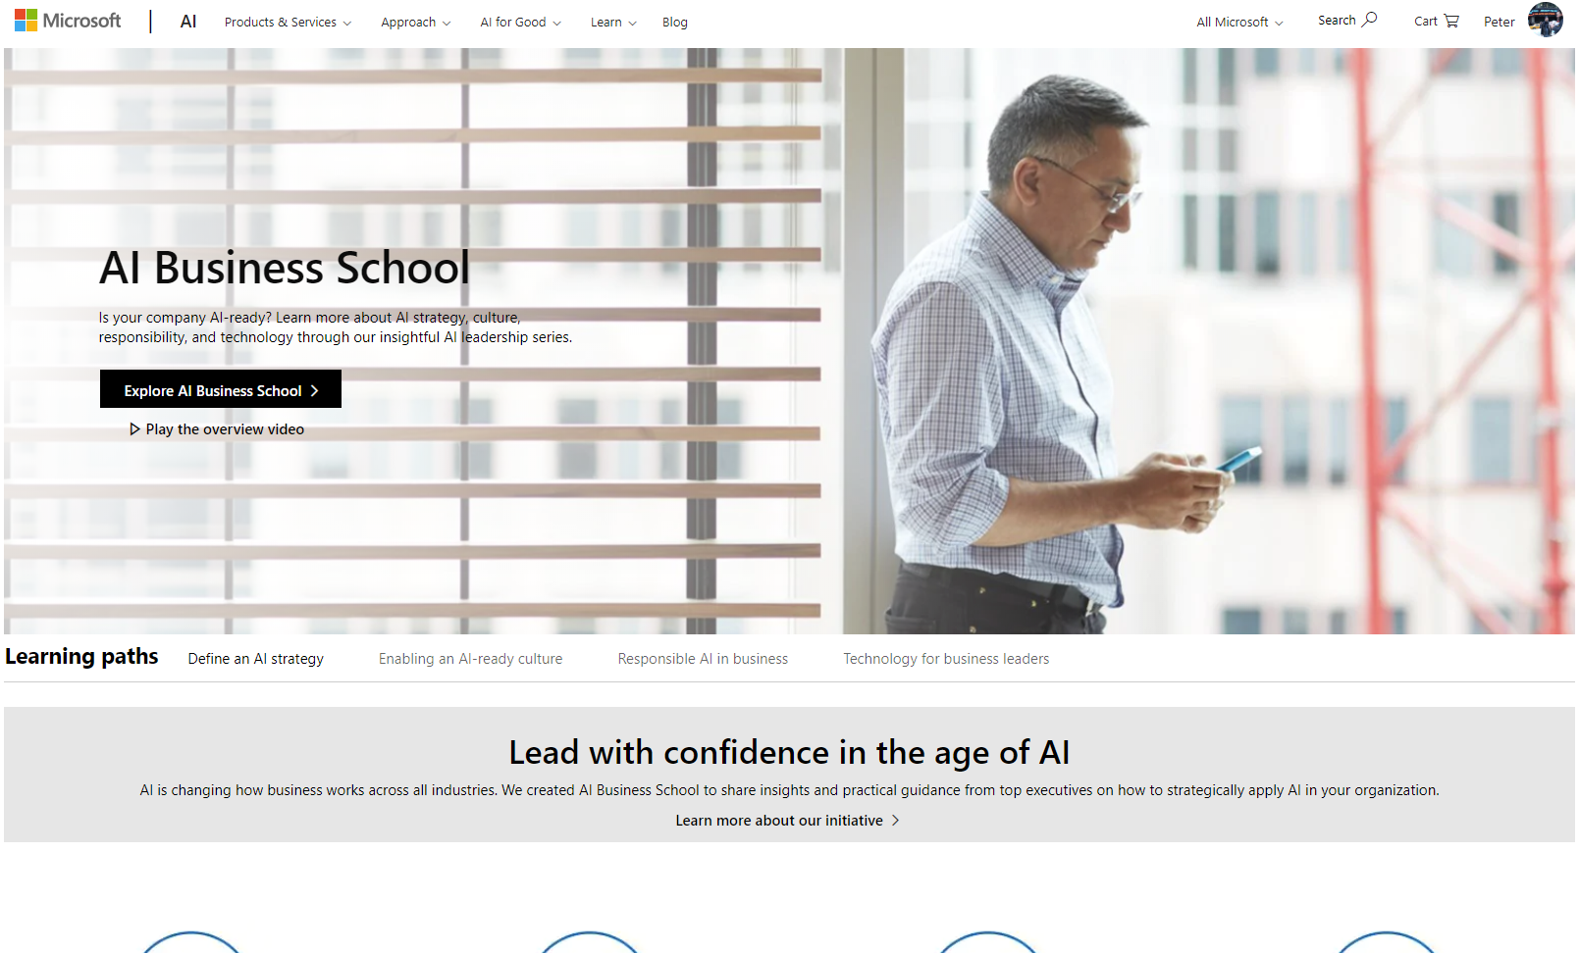

Microsoft AI Business School
Notes:
Videos and articles on how to define:
Education
Strategy
Shape and change culture
Being a responsible citizen

Slide 6
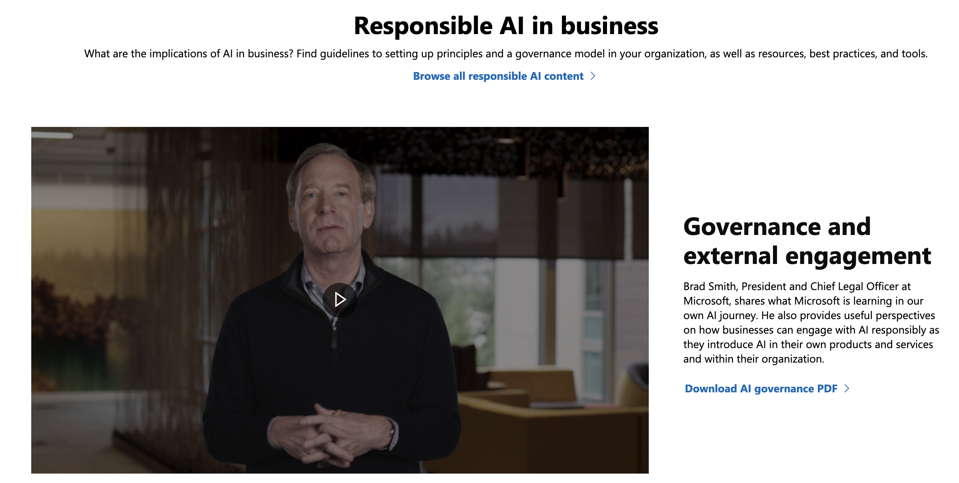
Microsoft AI Business School
Notes:
Video:
https://www.microsoft.com/en-us/ai/ai-business-school?&OCID=AID620867_SEM_zFIFLiTR#primaryR6

Slide 7
Custom Vision
Workspace
Area of Focus
Tags – Single or Multiple
Tagging Strategy
Model
Iterations
Improving Performance and Accuracy
Notes:
Walkthrough of the Custom Vision workspace
Choosing what to focus (business value)
Tags – images can have single or multiple tags, need to define that
What is the tagging strategy
Images and building your training model
Iterations
Improving Performance and accuracy when training the model

Slide 8
Demo
Notes:
Custom Vision AI Main Portal - https://www.customvision.ai/
Test image URLs:
Google Coffee mugs images
Chewy
https://9to5toys.com/wp-content/uploads/sites/5/2019/04/zak-designs-chewbacca-mug.jpg
Cognitive Services:
https://docs.microsoft.com/en-us/azure/cognitive-services/custom-vision-service/export-delete-data
Cognitive Services API (Swagger, etc) -https://southcentralus.dev.cognitive.microsoft.com/docs/services/57982f59b5964e36841e22dfbfe78fc1/operations/5a3044f608fa5e06b890f164
PostMan sample call will provide iteration id, prediction information, etc.

Slide 9
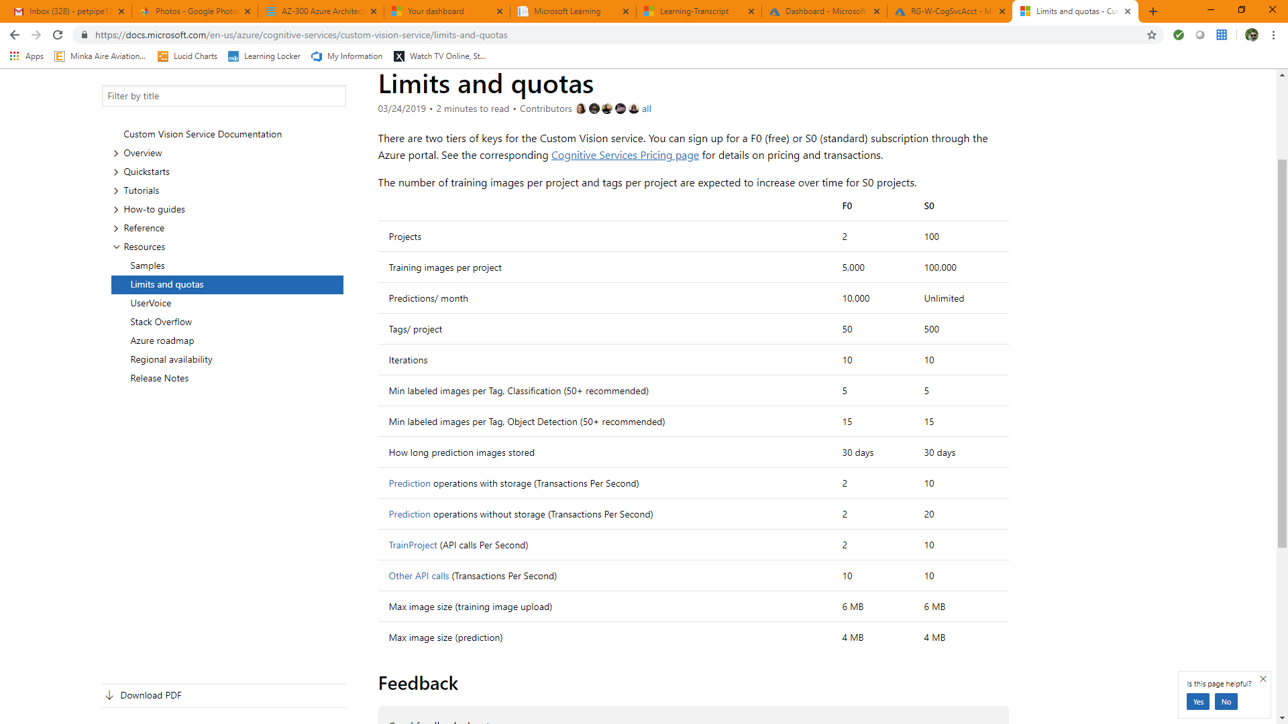
Quotas & Limitations

Slide 10
Intelligent Edge
Containerization:
Analytics – Text, Streaming
Face – Gender, Age, Emotion
Custom Vision – Classification, Object Detection
Notes:
Process to enable Containerization of these Intelligent Edge components. They are not turned on by default.
Not a full list of capabilities shown

Slide 11
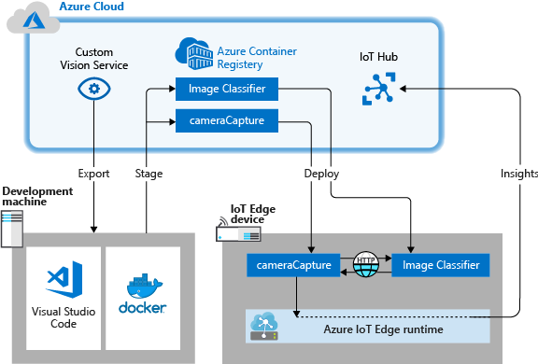
Intelligent Edge - Containerization

Slide 12
Intelligent Edge – Data Box Edge
Field Gateway – reducing the network consumption
Shared AI trained model and Compute
Pre-Processed data and Sync to Azure capabilities
Notes:
Ref URL: https://docs.microsoft.com/en-us/azure/databox-online/data-box-edge-overview
https://azure.microsoft.com/en-us/services/iot-edge/
https://docs.microsoft.com/en-us/azure/iot-fundamentals/iot-security-architecture

Slide 13
Summary
Consumption – AI Business School
Custom Vision – Design and Implementation
Demo

Slide 14
Thank You!

Slide 15
Links
Mile High Azure Meetup - https://www.meetup.com/mile-high-azure
MSFT AI Biz School - https://www.microsoft.com/en-us/ai/ai-business-school
Custom Vision AI Portal - https://www.customvision.ai/
Cognitive Services - https://azure.microsoft.com/en-us/services/cognitive-services/
Intelligent Edge - https://azure.microsoft.com/en-us/blog/bringing-ai-to-the-edge/
Intelligent Edge Containerization Deployment - https://docs.microsoft.com/en-us/azure/iot-edge/tutorial-deploy-custom-vision
Pricing – https://azure.microsoft.com/en-us/pricing/details/cognitive-services/custom-vision-service/
Quotas and Limits - https://docs.microsoft.com/en-us/azure/cognitive-services/custom-vision-service/limits-and-quotas
How to improve your classifier - https://docs.microsoft.com/en-us/azure/cognitive-services/custom-vision-service/getting-started-improving-your-classifier

Slide 16
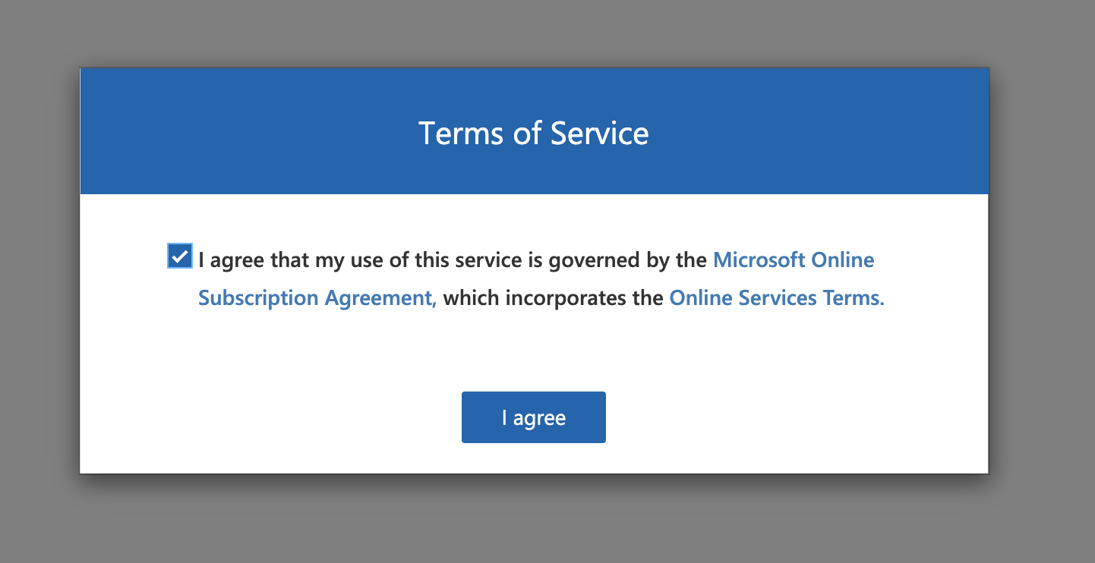
Reference Images – Initial ToS Screen

Slide 17
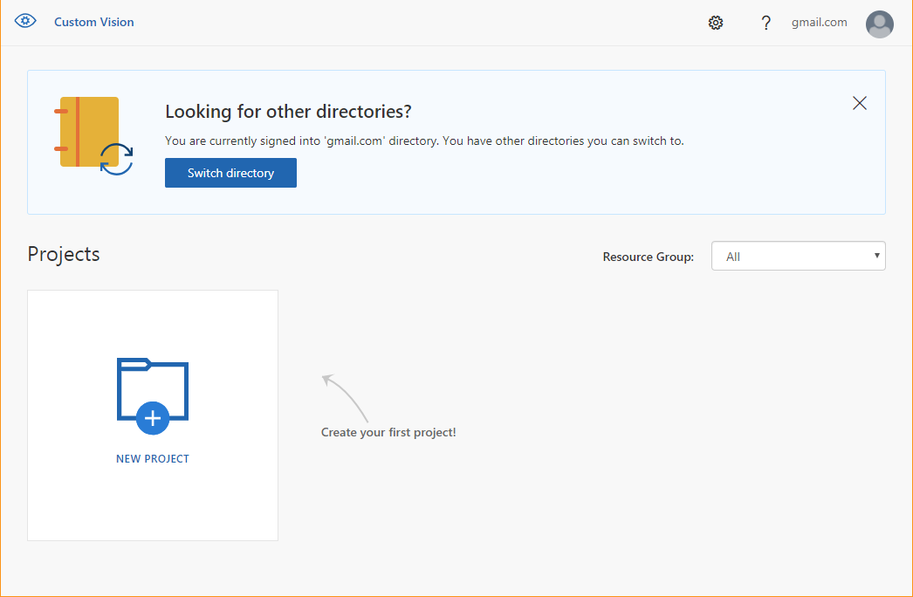
Reference Images – AI Portal

Slide 18
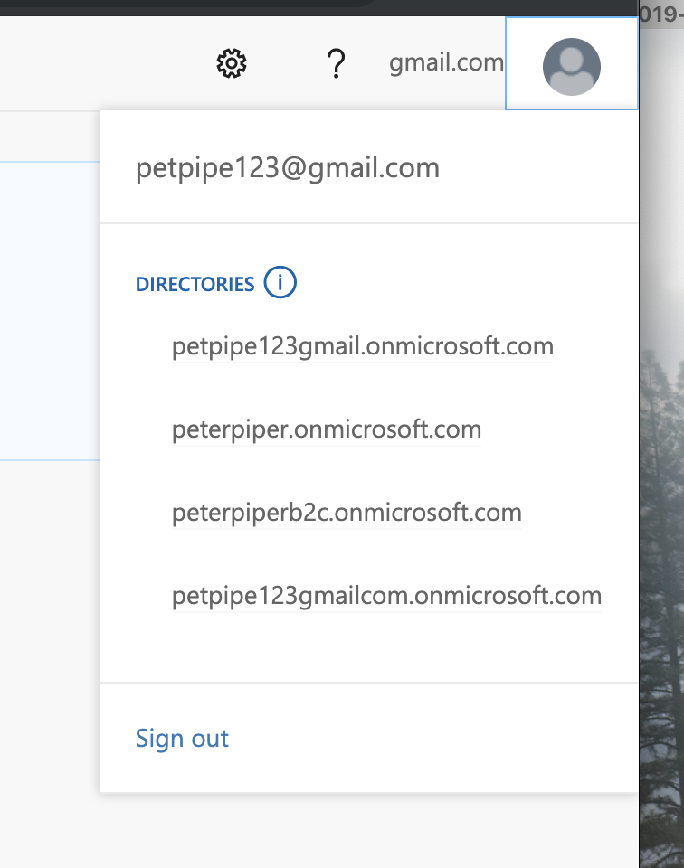
Reference Images – Directories

Slide 19
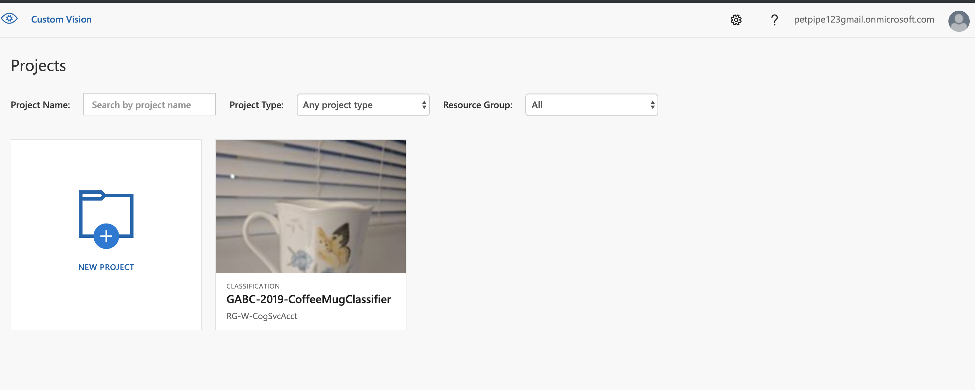
Reference Images – Projects

Slide 20
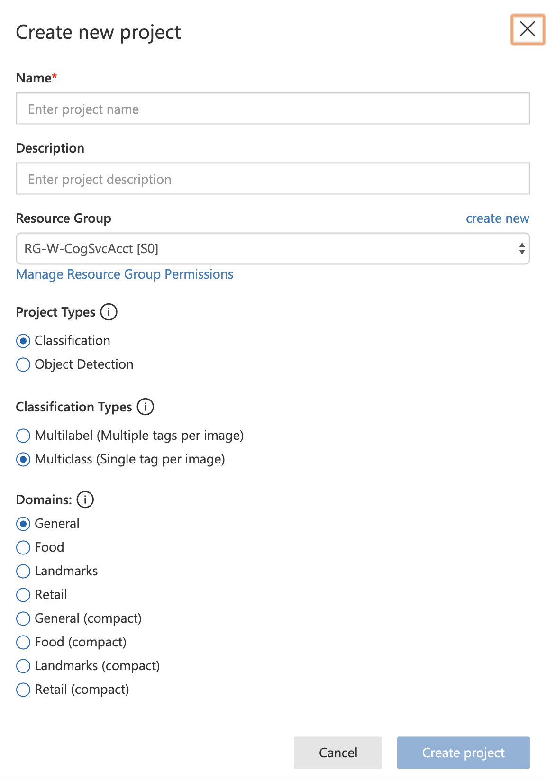
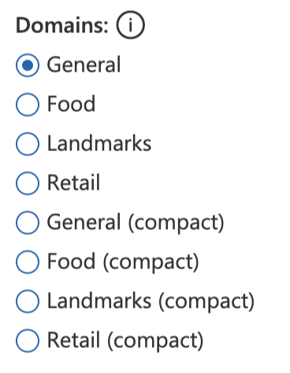

Reference Images – New Project
Notes:
Compact Project types are required when creating a container of the Custom Vision project

Slide 21
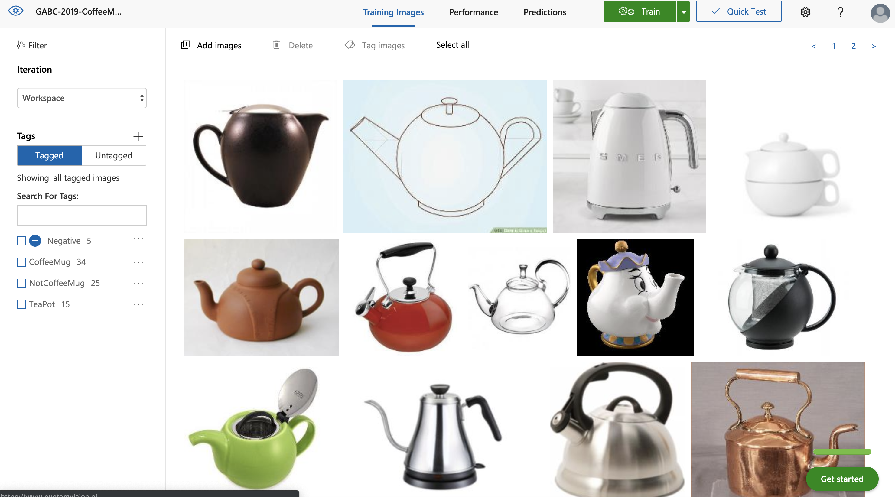
Reference Images – Existing Project

